Slide 1
Project:
Real-Time visualization of location and movement of assets in an intermodal hub terminal.

Slide 2
Backdrop of usage:
In existing systems for tracking of assets uses parameters for asset location, such as, ROW no., LOT no., SPOT no. But it is difficult to track an asset such a way as it requires a prior knowledge of hub layout.
Information regarding the status and location of an asset is available through webpages. Also the information is updated manually which if not done at correct time might cause inconsistency for relocating or reassigning the particular asset. So somehow other users need to be updated with the correct information regarding the asset at a real-time basis.

Slide 3
Project Description:
The application is based on a Node.js framework using socket.io and expressjs modules for server script using MongoDB for database.
In an intermodal hub information about assets (containers, chassis, crane, etc.) remain stored in the database.
This information is visualized in form of a map-based layout of the intermodal hub.
Whenever any asset is relocated and reassigned, this information, the movement and changed status is visible to other users tracking the assets at real-time along with notifications regarding this movement.
Simultaneously this changed information about the assets get updated in the database.

Slide 4
Architecture:
When server is started, it connects to the mongoDb server generated previously and any request from client for database access is mediated through the server only.
The events occurring at the client side are used to generate socket events.
These socket events when recorded at the server they act as event handlers for these events, for instance, querying the database, updating the database or broadcasting data packet to other users.

Slide 5
Overview:
The assets are displayed over the screen as over a layout of the intermodal hub.
Whenever an user requires to move a particular asset he would just have to update the location on the layout by dragging and dropping the asset.
Now, if the asset to be relocated or reassigned is already being used by some other user then the concerned user would not be able to do so.
While an asset is being used its changed status is visible to other users by the change in background color of the objects.
Also the movement would be visible to other users at real-time.
Whenever there is a change in position of a particular asset it is broadcasted to other users as well as broadcasted to other users.

Slide 6
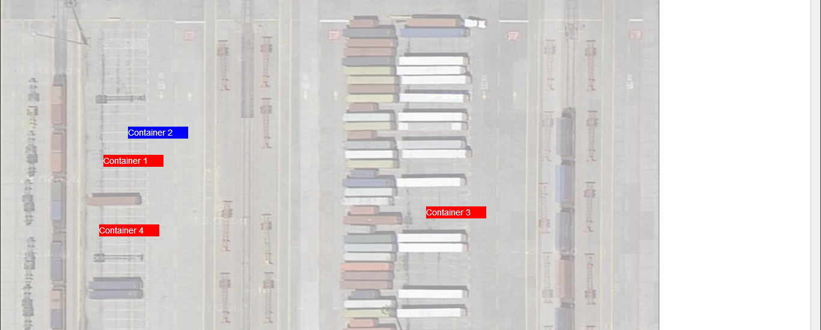
Hub Layout
The blued container suggests that the “Container 2” is being used by some other user and hence cannot be dragged.
This changed status is visible to all other users showing the movement at real-time.

Slide 7
The users are notified of all kinds of movements along the screen.
These notifications are available in the notifications column. If mouse pointer is hovered over a particular
notification, the movement mentioned in the notification is displayed on the screen.
The users have a enable/disable option for the display of the movement of assets along the screen.
While disabling the display, the user can have the movements performed while disabled using the show path
option. Now with show path all the movements path will be displayed. So to make it easier to track a particular
path a mouse over on a particular path highlights the path.
Whenever the display is disabled if some object is moved by some other users, the movement would not
be displayed to other users and hence if they want to move the said object, he would get an alert to update
the display with the current locations for the objects as present in the database.
Also at any point of time an “Update” operation would clear all the previous location information of the
objects stored with the browser and also remove the notifications from the notifications column.

Slide 8
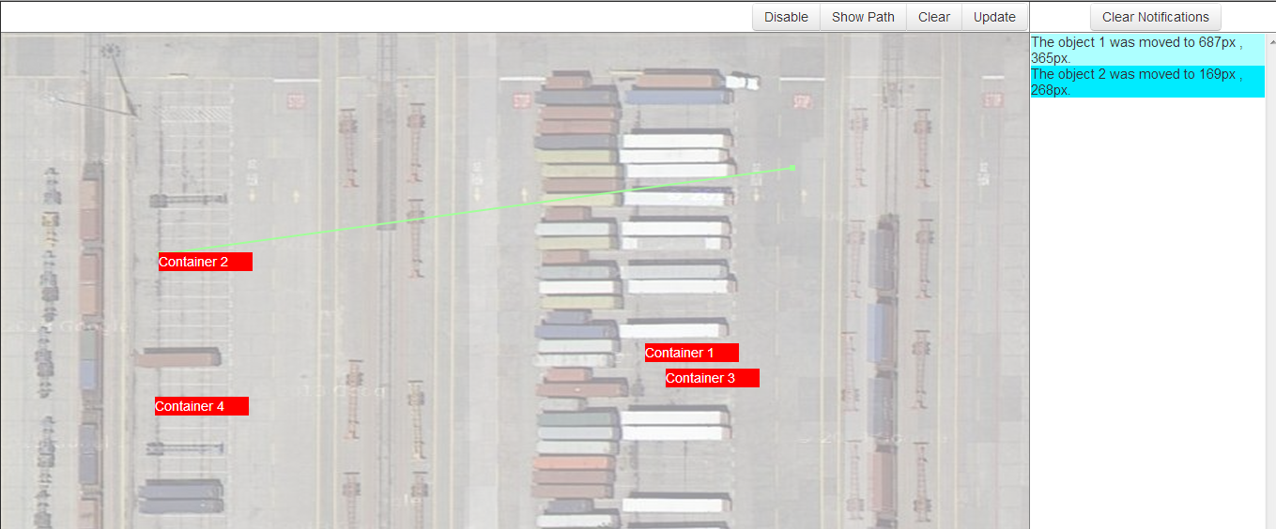
Notifications for movement done by others
The 2nd notification as shown gives the details of movement of container 2 performed by some other user.
The mouseover on the said notification gives the path for the movement which is removed on mouseout.

Slide 9
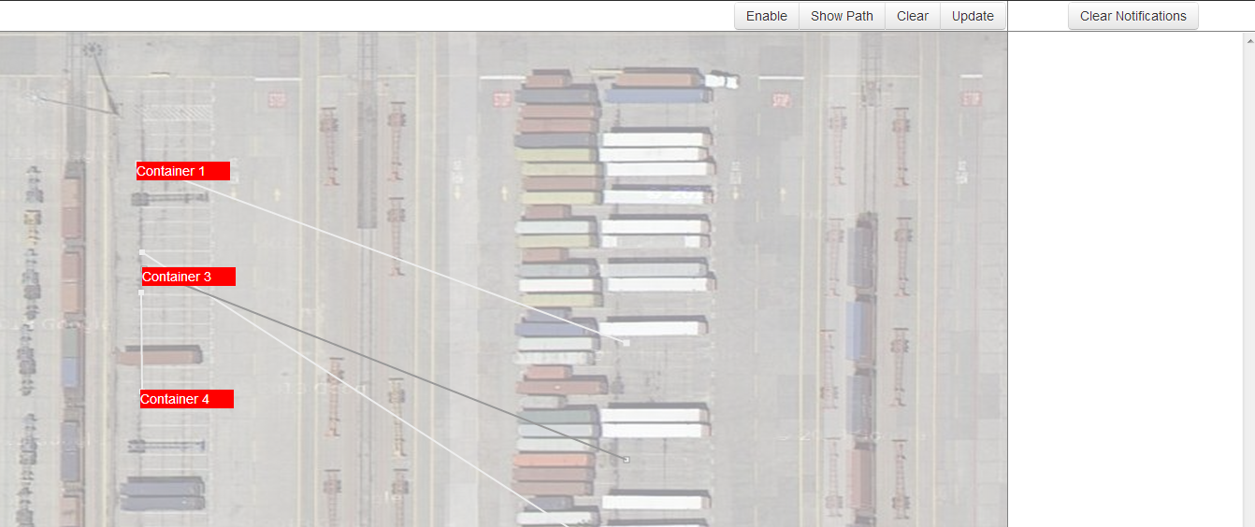
“Show Path”
All the previous paths traced by the objects are displayed whereas the path with the mouse pointer over it gets highlighted.

Slide 10
Some cases there might be one container placed over another thus making it difficult to track or move .So in such
cases by right clicking on the particular location the user would get the list of available assets at the location .

Slide 11
Future Scope:
The asset information can be viewed by mouseover on the particular asset as a pop-up.
The access and modification of asset information can be restricted to various levels of authorization.
Historical data of the assets can also be visualized.
If any update of the database is done from the server side the users can be notified of that.
The layout for the hub can be divided into various sections as per the intermodal hub.

Slide 12
Software Requirements:
Node.js
This is the framework for the server.
MongoDb
This is the database framework for storing the asset information.
IE 9+ ,Google Chrome , Firefox, etc.
This is required to support SVG used to draw movement path of an asset at runtime.

Slide 13
Plugins used:
Socket.io, expressjs, mongoDb-native --- for node.js server framework
D3.js --- for drawing paths of movement at runtime
Twitter-bootstrap --- for UI (buttons)
jQuery-contextMenu --- for custom right-click options

